Slide 1
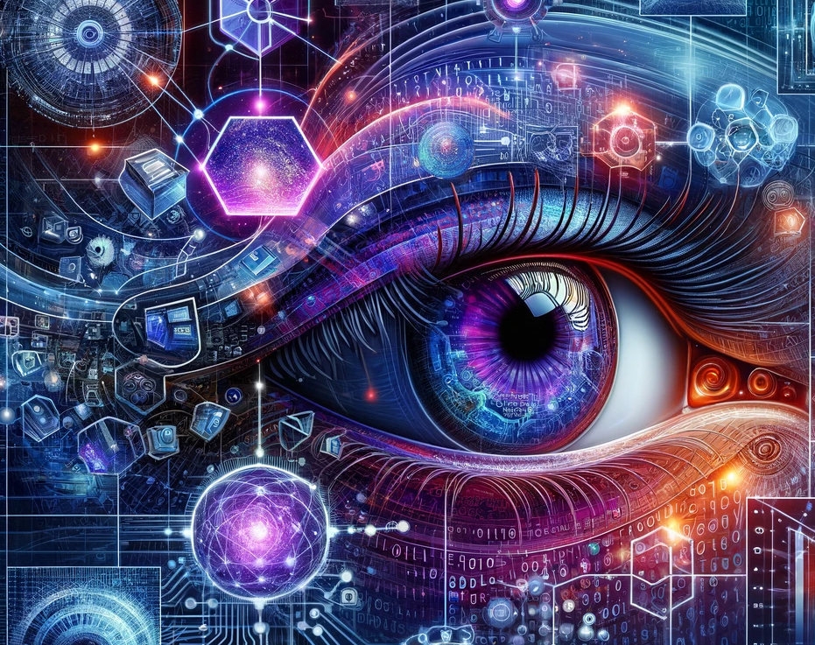
Using AI and Image Processing to Improve Fatigue Failure Analysis in 3D-Printed Materials
Jonatan Boritski
Avichay Mazin

Slide 2

Introduction
3D printing (Additive Manufacturing) is used to create complex parts in industries like aerospace and automative.
These materiales can experience fatigue failure due to repeated stress over time.
Traditional analysis methods are slow, manual, and prone to errors.
Our solution: Using AI and image processing to automate and improve this analysis.
Benefits: Faster, Automate vs manual, More accurate, better failure prediction.

Slide 3
Additive Manufacturing & Fatigue Failure
What is Additive Manufacturing (AM) ?
3D printing technique used to create parts layer by layer.
Popular in aerospace and automotive for lightweight and complex designs.
Fatigue Failure in Materials:
Repeated stress leads to material failure (cracks, fractures).
Challenges with Traditional Analysis:
Involves manual fractography, where experts visually examine fracture surfaces.
Time-consuming, prone to human error, and lacks scalability.
Difficult to predict when and where cracks will occur.

Slide 4
AI and Image Processing Approach
Our solution:
Combine image processing techniques and AI to analyze fatigue failure in 3D printed materials.
Key steps: Image Proccesing:
Use sobel operator to detect edges for generate heatmaps for identifying critical features (crack ares).
Preproccesing:
resize and clean Scanning Electron Microscope (SEM) images for uniforn analysis.
AI (Unet model):
Apply UNet architecture for image segmentation.
Detect external contours (whole surface) and internal contours (crack propagation) in fracture surfaces.

Slide 5
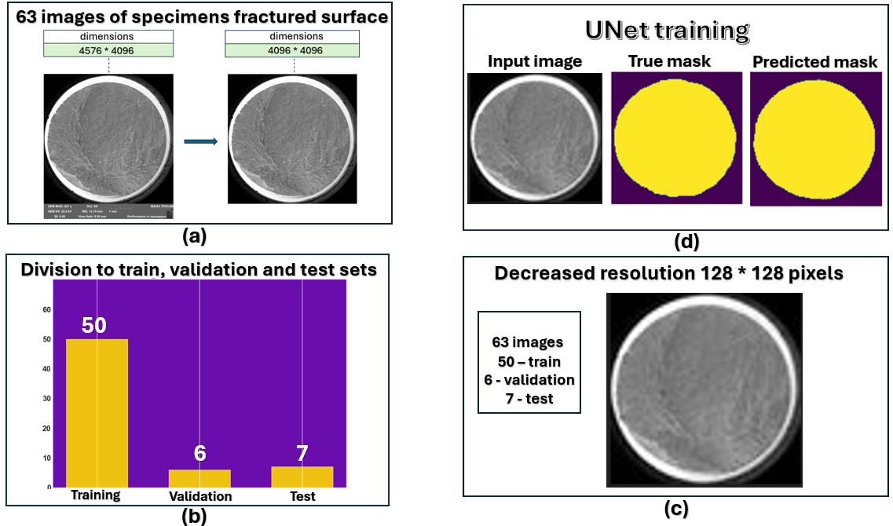
Visualization of the Process

Slide 6
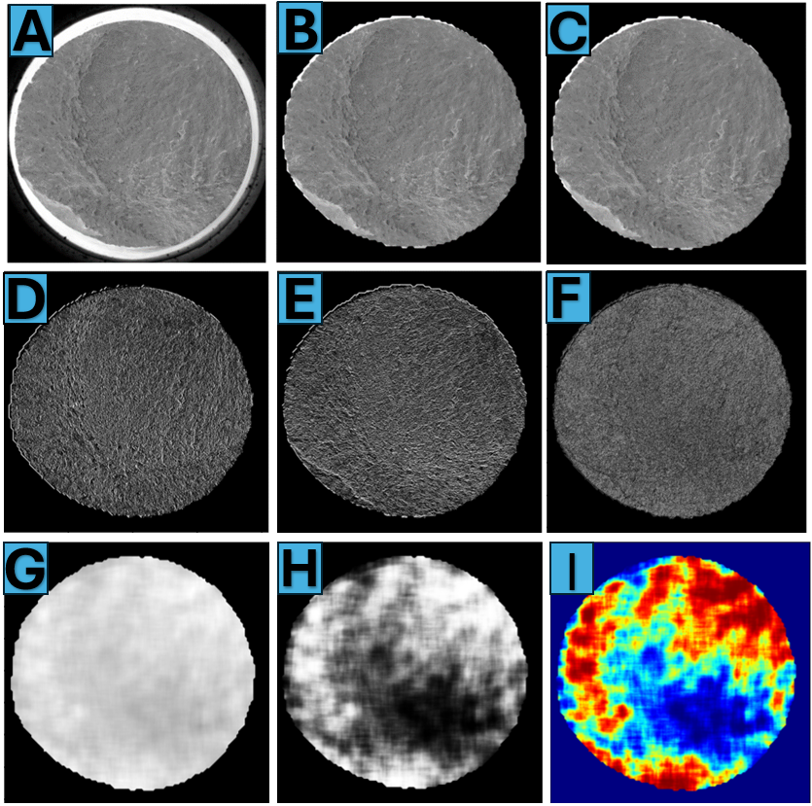
Visualization of the Process-
Heatmap

Slide 7
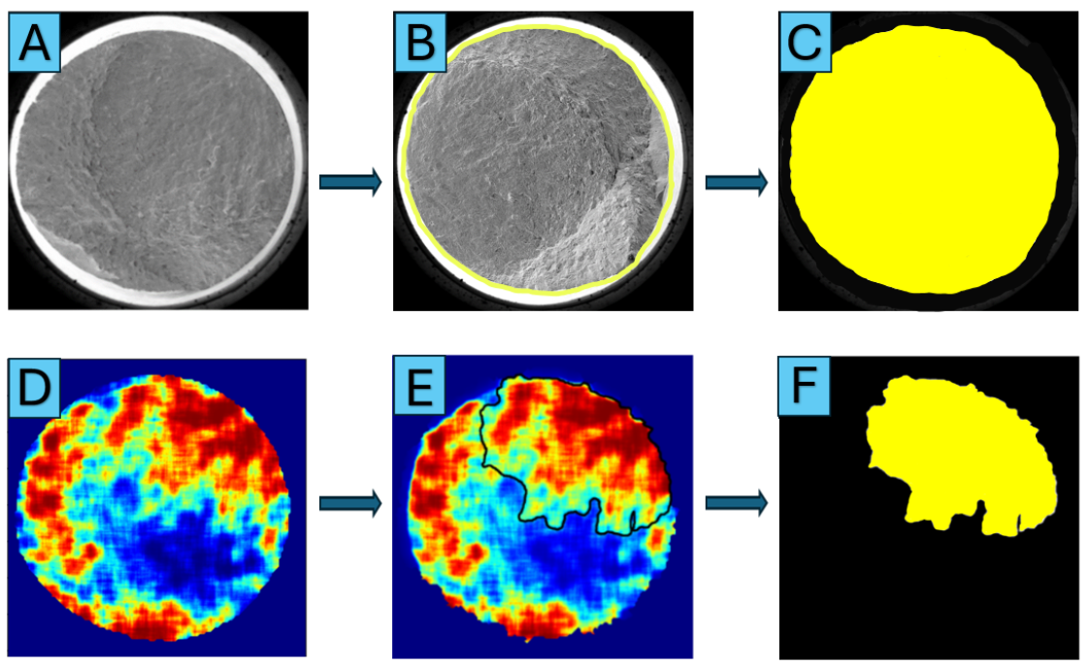
Visulaization of the Process –
Labeling

Slide 8
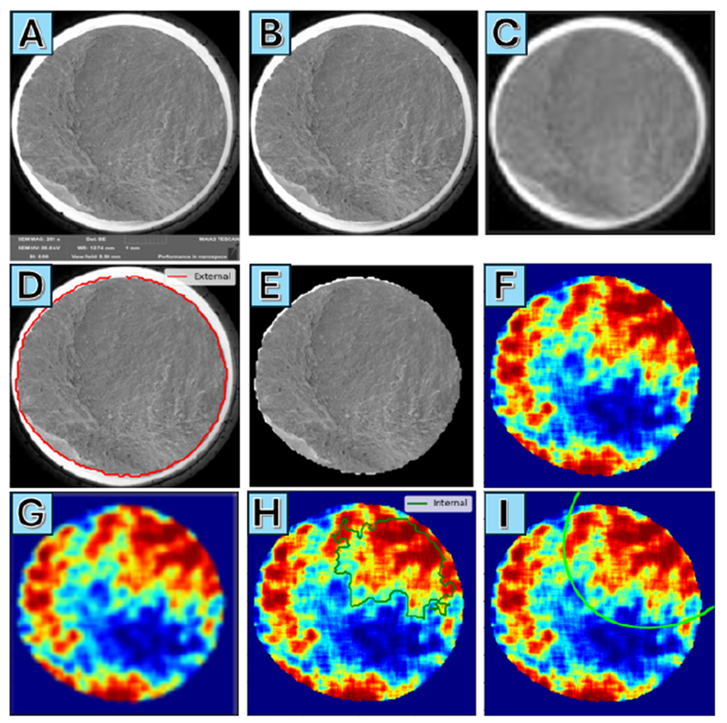
Visualization of the Process –
Get ellipse

Slide 9
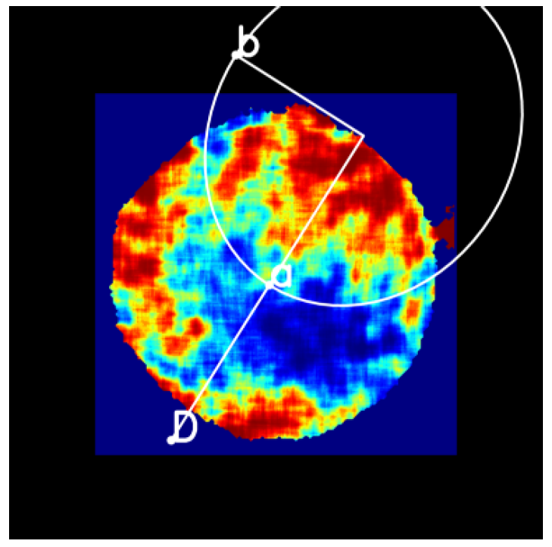
Visualization of the Process –
Get ellipse

Slide 10
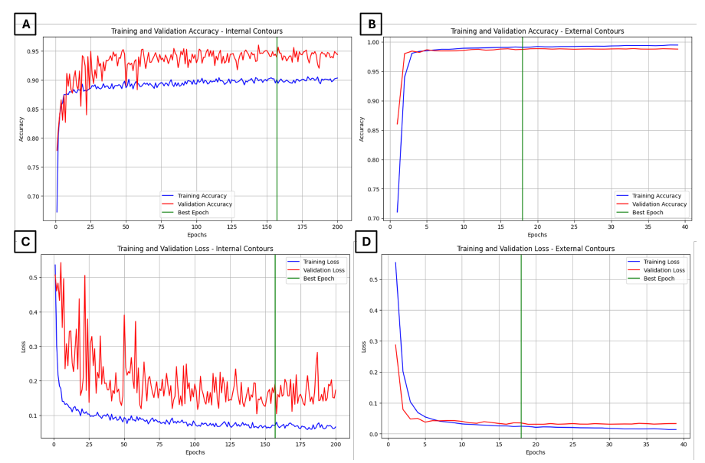
Results
Training and Validation accuracy and loss –
External and internal contours

Slide 11
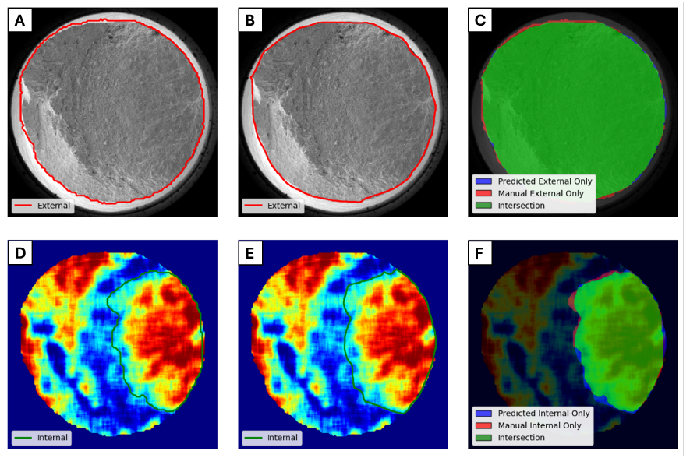
Results
IOU - (Intersection Over Union)
External contour detection achived 0.97 in the IOU.
Internal contour detection achived 0.93 in the IOU.

